Slide 1
EDA on Used Car Sales
Saba Tasnim

Slide 2
Introduction
Dataset contains one of the used cars company sales
~10K records
Few decades sales history
Visual Data Analysis

Slide 3
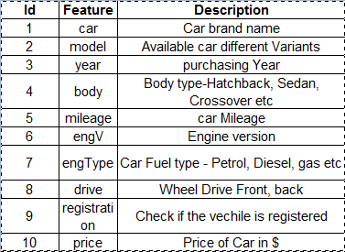
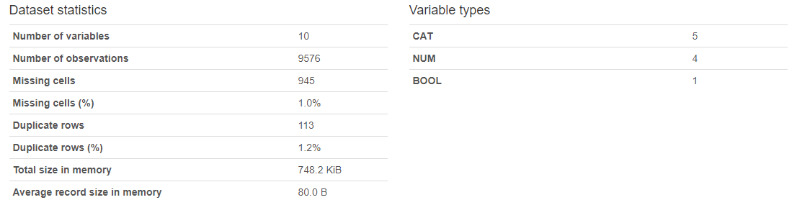
Introduction
Feature Description
Profiling Report

Slide 4
Problem Statement
The company has earned its name because of sincerity in work and quality of services
But for past few months their sales is down

Slide 5
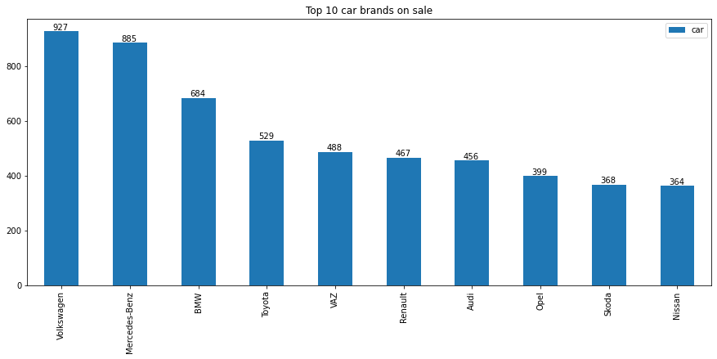
Data Exploration

Slide 6
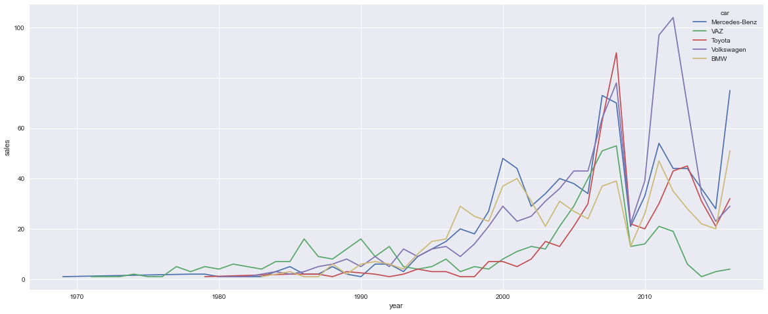
Data Exploration
Year wise car sales

Slide 7
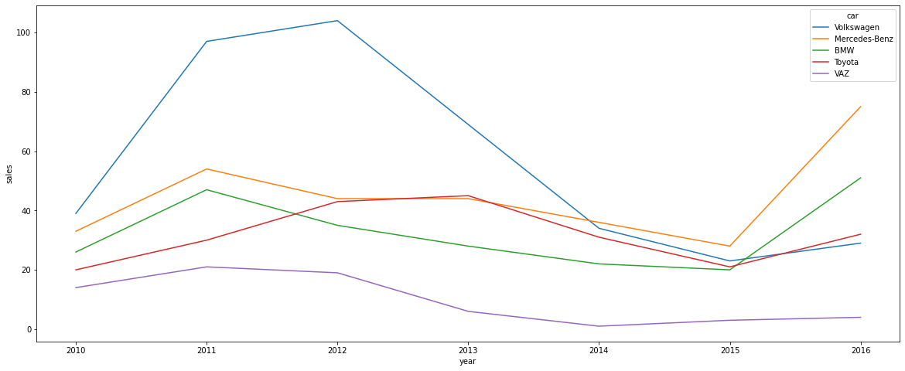
Data Exploration
Year wise recent car sales

Slide 8
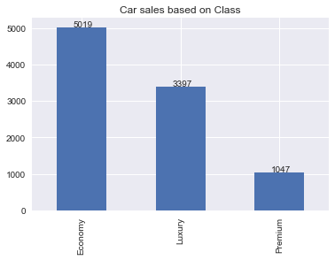
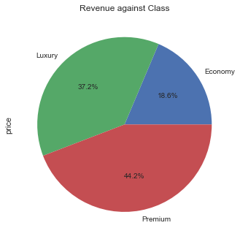
Data Exploration

Slide 9
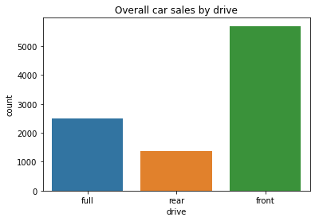
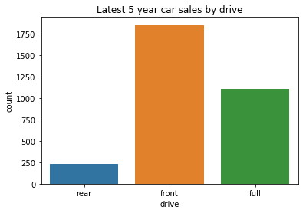
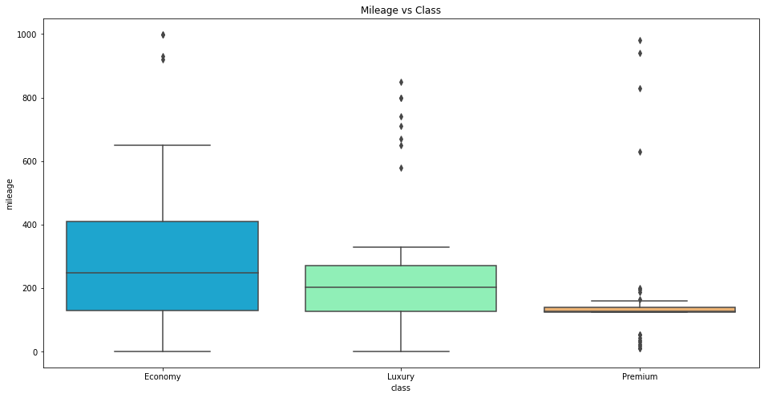
Data Exploration

Slide 10
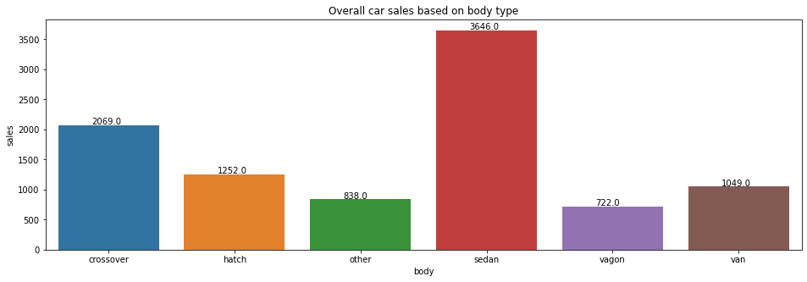
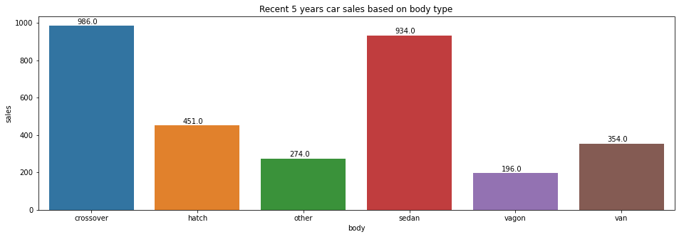
Data Exploration

Slide 11
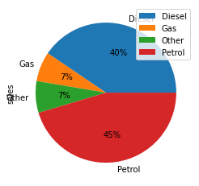
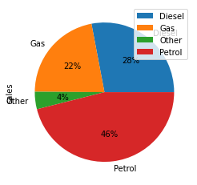
Data Exploration
Overall sales by eng Type
Recent sales by eng Type

Slide 12
Observations & Conclusions
Most sales happening price range is between 10000 to 40000 /-
There are very few cars sold in 20000 to 36000 price bracket, which is best competitive
price range
Economy cars are mostly comes with Gas engines, but in the recent days customers are
not preferring Gas cars. Where as
Petrol car sales are consistent
Diesel car sales are gaining momentum
Other car sales are gradually increasing
None of the cars sold from Economy segment in year 2016.
Car registrations are most considered in Luxury and Premium cars
Even with affordable price range, gas and other engine type cars are least preferred.
Most preferred
•engine types are Petrol and Diesel
•body types are cross-overs and sedan
•Other type cars are consistent and gradually increasing in sales
Overall, Sedans are always on demand follows with Cross-over and hatch.
Tremendous sales reported in 2016 for these super premium cars by Bentley, LandRover, Toyota, Tesla, Lexus, Cadillac & BMW
Recently Crossovers are leading in sales followed by sedans
Most of the recent premium cars engine type is Petrol

Slide 13
Actionable Insights
Cars should be available from all price ranges.
As 10000 to 40000 /- is the most sales happening price range and there are no cars available in 20000 to 36000 /- price bracket, procuring these price ranged cars should potentially improves the sales.
Procure cars based on customer trends
Petrol & diesel car are most popular
Full wheel drive is most preferred in Crossovers& Front wheel drive in Sedan
Luxury& Premium cars booming sales due to hike in new car price
Tactical & Strategic Decision
Less preferred old cars should be announced with great deals and clear the stock. In that way we can save money, renting space for storage
Procure more demanded cars like Mercedes-Benz, BMW, Volkswagen, Toyota, Nissan, Ford, Audi.. etc
Procure more Economy price range cars which is of Petrol or Diesel engine types

